Slide 1
X-Prod: Efficient and Scalable Cartesian Product distribution
{gopalv,zhiyuany,hitesh}@apache.org

Slide 2
Why?
Cartesian products show up without being invited
Theta Joins – Non-equality, Inequality, Complex joins, Skew Joins
select count(1) from txns t join fraud f on (t.buyer = f.user or t.seller = f.user)
Geo-spatial queries
select borough, count(crime) from reports, nyc where ST_contains(region, location) group by borough
Similarity queries
select count(distinct sample_id) from samples s, bases b where distance(s.bits, b.bits) <= 5
Bi-Temporal Overlaps
select r.period, r.value from rpm r, temp t where OVERLAPS(r.period, t.period) and t.value > 515

Slide 3
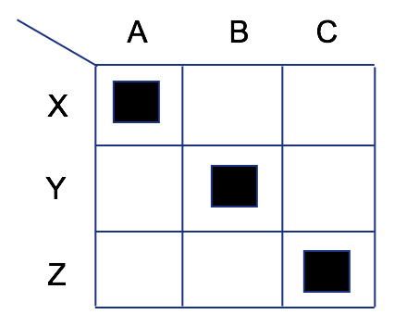
Shuffle
Map –shuffle- Reduce
Shuffle operates based on partitions
Every mapper writes out N partitions
There are N reducers downstream
Each of N reducer fetches the i^{th} partition
To produce a join
Each table is assigned a tag
Mapper writes out N partitions by partition(key)
Each partition ordered by key,tag
The Reducer fetches i^{th} partition
Performs a sort-merge & feeds a join
Notes:
Cross-products don’t have keys, so the partitioning is broken and

Slide 4
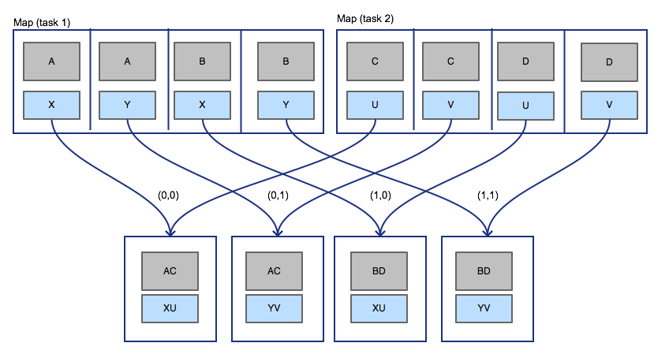
Synthetic JOIN
Cross-products don’t have keys
Notes:
Synthetic join keys can be used to produce parallelism at the expense of writing extra data to the partitions

Slide 5
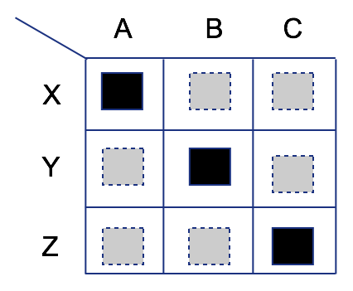
Synthetic SHUFFLE
Tez Edge Plugins
Tez changed shuffle into a routing layer
Every task sends out N-events
Every reducer gets N-events
A regular Shuffle runs N reducers
A naive X-prod runs N^2 reducers
Tez can also merge adjacent partitions
Run fewer tasks
Merge fetches for same task

Slide 6
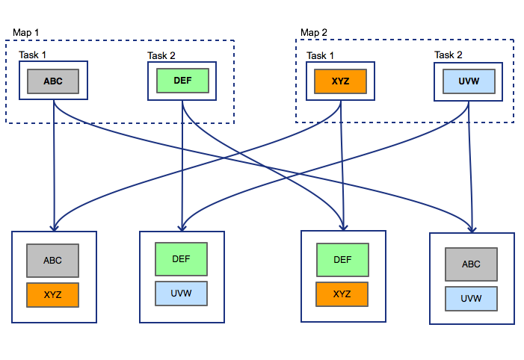
X-PROD
Swapping partition <-> task-id
Join has (J + K) tasks
Every task sends out 1 event
Every reducer gets 2 events
Tez runs J * K reducers

Slide 7
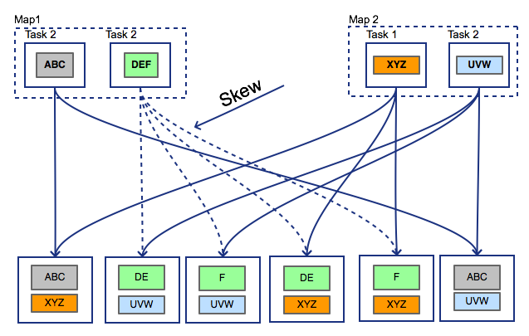
Input Skew X-PROD
Bring back partitions
Join has (J + K) tasks
Every task sends out P events
Every reducer gets 2 composite events
Event Group P * J => N chunk events
Event Group P * K => M chunk events
cross((P_J),(P_K)) => N * M tuples
Schedule N * M reducers

Slide 8
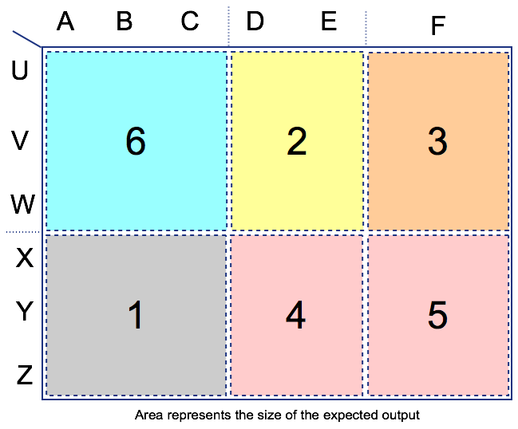
Fair GROUPING
Merge partitions if we can
Grouping heuristic with size goals
Task output size has a counter
Chunking is done per-task input
Each chunk only fetches from one node
Each chunk spans continuous partitions
Minimum size of a chunk is 1 partition
Grouping tries to merge chunks
Merge by host to reduce network hops

Slide 9
LOCALITY SCHEDULING
Reducers with locality
Grouping by host merges only one side
Composite events produced have locality
Both events in the tuple have locality
Scheduling can pick heavy-side locality
Both host and rack locality
Tez Shuffle has a local short-circuit path
File permissions within the same DAG

Slide 10
thanks to the Apache TEZ & ApACHE HIVE communitIES

Slide 11
BENCHMARKS
1 hour to 1 minute
CREATE TEMPORARY TABLE Distance_H_H as
SELECT Postal1, Postal2, 6371 * ( 2 * asin(if(1<sqrt( pow(sin( (latRad2 - latRad1)/2 ),2) + cos(latRad1) * cos(latRad1) * pow(sin((longRad2-longRad1)/2),2)),1, sqrt( pow(sin( (latRad2 - latRad1)/2 ),2) + cos(latRad1) * cos(latRad1) * pow(sin((longRad2-longRad1)/2),2)))) ) as Distance
FROM v_postal_H_H
WHERE TblID1<TblID2;

